Slide 1
CHGM-141
General and Analytical Chemistry I
Lecture 18
(Ch. 6, 7) with Dr. Bailey
SOLUTIONS
Electrolytes and Nonelectrolytes
The pH Scale
Solubility of Ionic Compounds

Slide 2
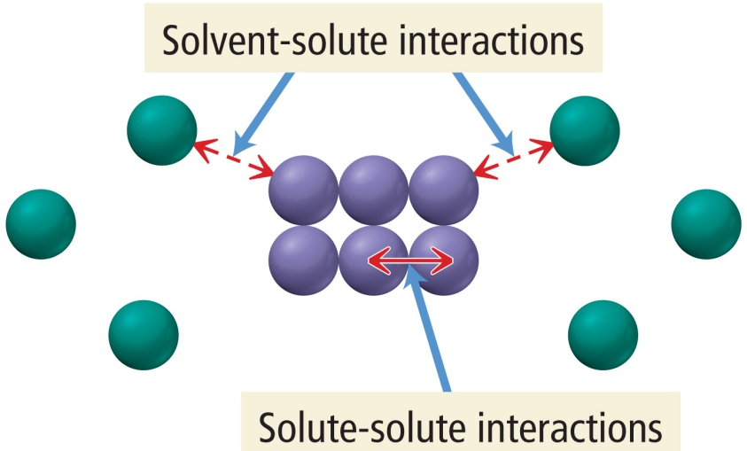
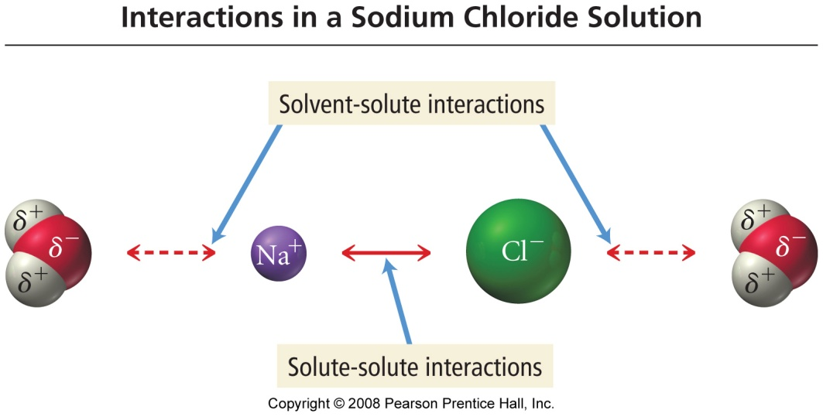
What Happens When a Solute Dissolves?
there are attractive forces between the solute particles holding them together
there are also attractive forces between the solvent molecules
when we mix the solute with the solvent, there are attractive forces between the solute particles and the solvent molecules
if the attractions between solute and solvent are strong enough, the solute will dissolve

Slide 3
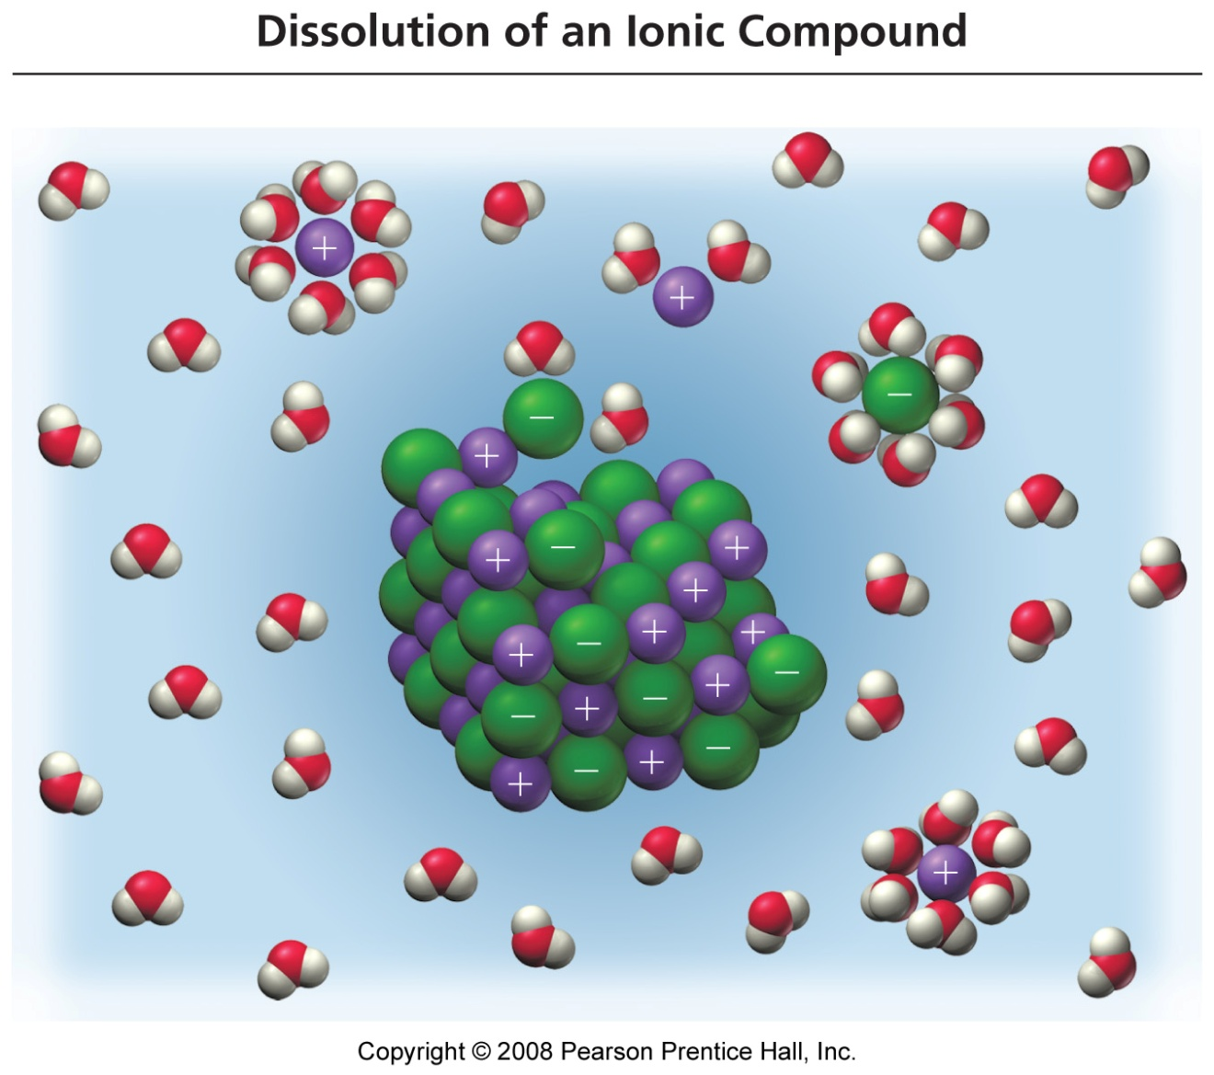
Table Salt Dissolving in Water
Each ion is attracted to the surrounding water molecules and pulled off and away from the crystal
When it enters the solution, the ion is surrounded by water molecules, insulating it from other ions
The result is a solution with free moving charged particles able to conduct electricity

Slide 4
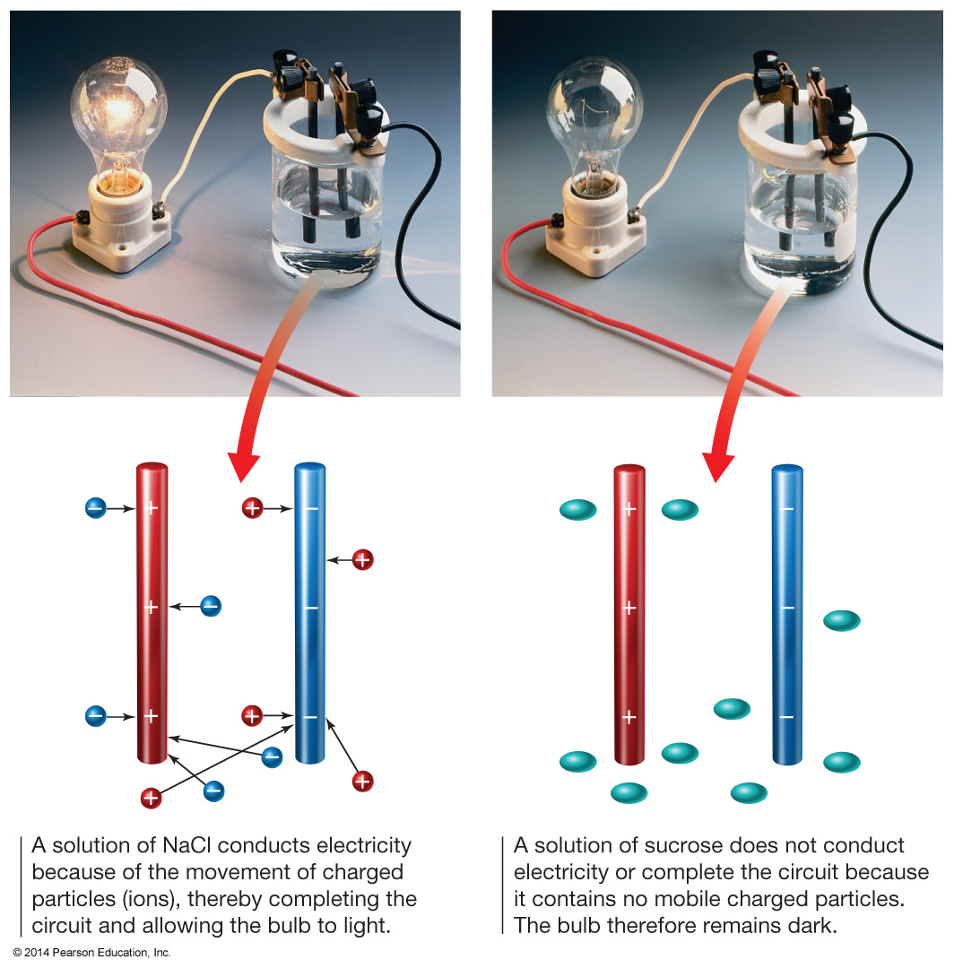
Electrolytes and Nonelectrolytes
materials that dissolve in water to form a solution that will conduct electricity are called electrolytes
materials that dissolve in water to form a solution that will not conduct electricity are called nonelectrolytes
Why?
in order to conduct electricity, a material must have charged particles that are able to flow

Slide 5
Molecular View of
Electrolytes and Nonelectrolytes
in order to conduct electricity, a material must have charged particles that are able to flow
electrolyte solutions all contain ions dissolved in the water
  ionic compounds are electrolytes because they all dissociate into their ions when they dissolve
nonelectrolyte solutions contain whole molecules dissolved in the water
  generally, molecular compounds do not ionize when they dissolve in water
    the notable exception being molecular acids

Slide 6
Electrolytes in Aqueous Solution
Dissociation Equations
H₂O
Na₂SO₄(s)
2Na⁺(aq) + SO₄^{2–} (aq)
H₂O
FeBr₃(s)
Fe³⁺(aq) + 3Br– (aq)
Notes:
Copyright © 2010 Pearson Prentice Hall, Inc.

Slide 7
Electrolytes in Aqueous Solution
Electrolytes: Substances that dissolve in water to produce conducting solutions of ions.
H₂O
NaCl(s)
Na⁺(aq) + Cl–(aq)
Nonelectrolytes: Substances that do not produce ions in aqueous solutions.
H₂O
C₁₂H₂₂O₁₁(s)
C₁₂H₂₂O₁₁(aq)
Notes:
Copyright © 2010 Pearson Prentice Hall, Inc.

Slide 8
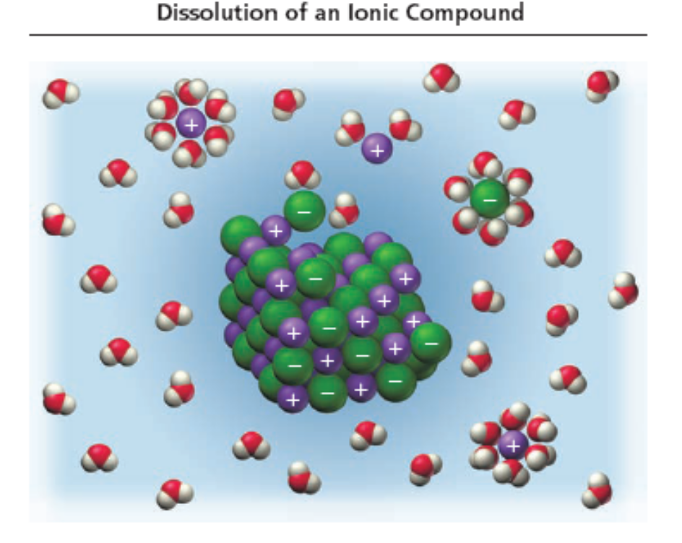
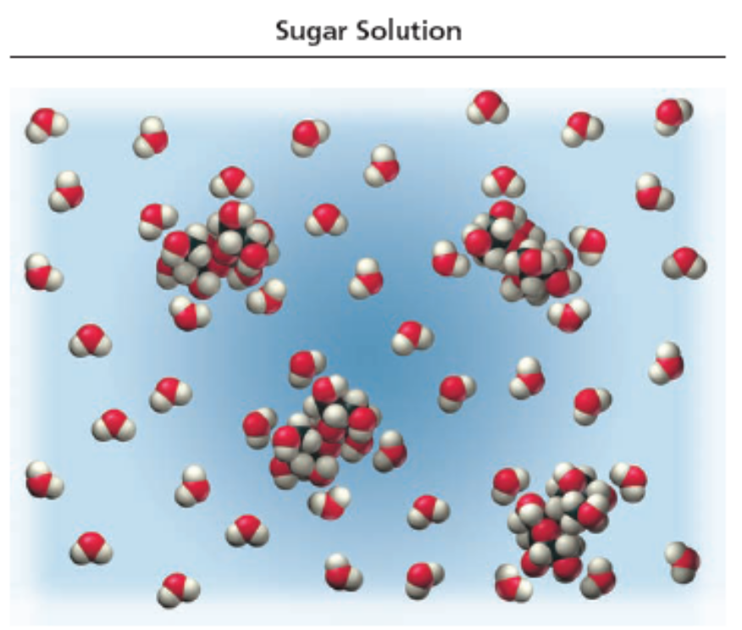
Salt vs. Sugar Dissolved in Water
ionic compounds dissociate into ions when they dissolve
(electrolyte solution)
molecular compounds do not dissociate when they dissolve
(nonelectrolyte solution)

Slide 9
Acids
acids are molecular compounds that ionize when they dissolve in water
  the molecules are pulled apart by their attraction for the water
  when acids ionize, they form H⁺ cations and anions
the percentage of molecules that ionize varies from one acid to another
acids that ionize virtually 100% are called strong acids
HCl(aq) → H⁺(aq) + Cl⁻(aq)
acids that only ionize a small percentage are called weak acids
HF(aq) ⇔ H⁺(aq) + F⁻(aq)

Slide 10
Strong and Weak Electrolytes
strong electrolytes are materials that dissolve completely as ions
  ionic compounds and strong acids
  their solutions conduct electricity well
weak electrolytes are materials that dissolve mostly as molecules, but partially as ions
  weak acids
  their solutions conduct electricity, but not well
Note: when compounds containing a polyatomic ion dissolve, the polyatomic ion stays together
Na₂SO₄(aq) → 2 Na⁺(aq) + SO₄²⁻(aq)
HC₂H₃O₂(aq) ⇔ H⁺(aq) + C₂H₃O₂⁻(aq)

Slide 11
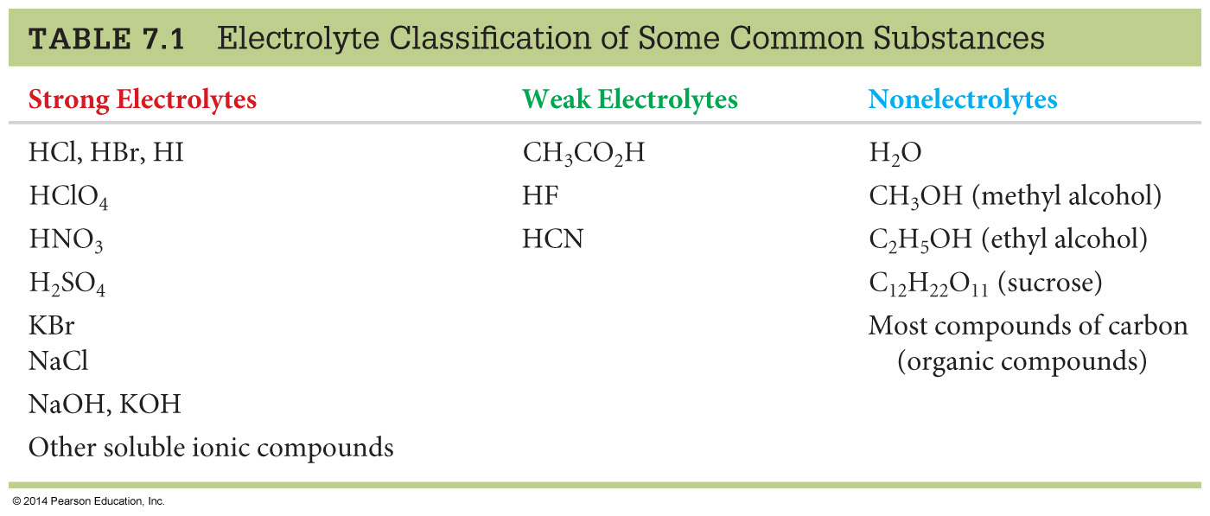
Electrolytes in Aqueous Solution
Strong Acids: Hydrochloric acid, hydrobromic acid, hydroiodic acid, perchloric acid, nitric acid, sulfuric acid.
Notes:
Copyright © 2010 Pearson Prentice Hall, Inc.
Strong acids are strong electrolytes (which is why they are called strong acids!). These are typically called the 6 common strong acids. There are other strong acids.

Slide 12
Electrolytes in Aqueous Solution
Ionic compounds
Notes:
Copyright © 2010 Pearson Prentice Hall, Inc.

Slide 13
Electrolytes in Aqueous Solution
Weak acids
Notes:
Copyright © 2010 Pearson Prentice Hall, Inc.
An acid that’s not a strong one is considered to be a weak acid.

Slide 14
Electrolytes in Aqueous Solution
Molecular compounds (other than any strong or weak electrolytes)
Notes:
Copyright © 2010 Pearson Prentice Hall, Inc.
Any molecular compounds that are not already classified (acids are molecular).
While water does dissociate to a small degree, we consider it to be a nonelectrolyte. The dissociation of water will be dealt with in a later chapter.

Slide 15
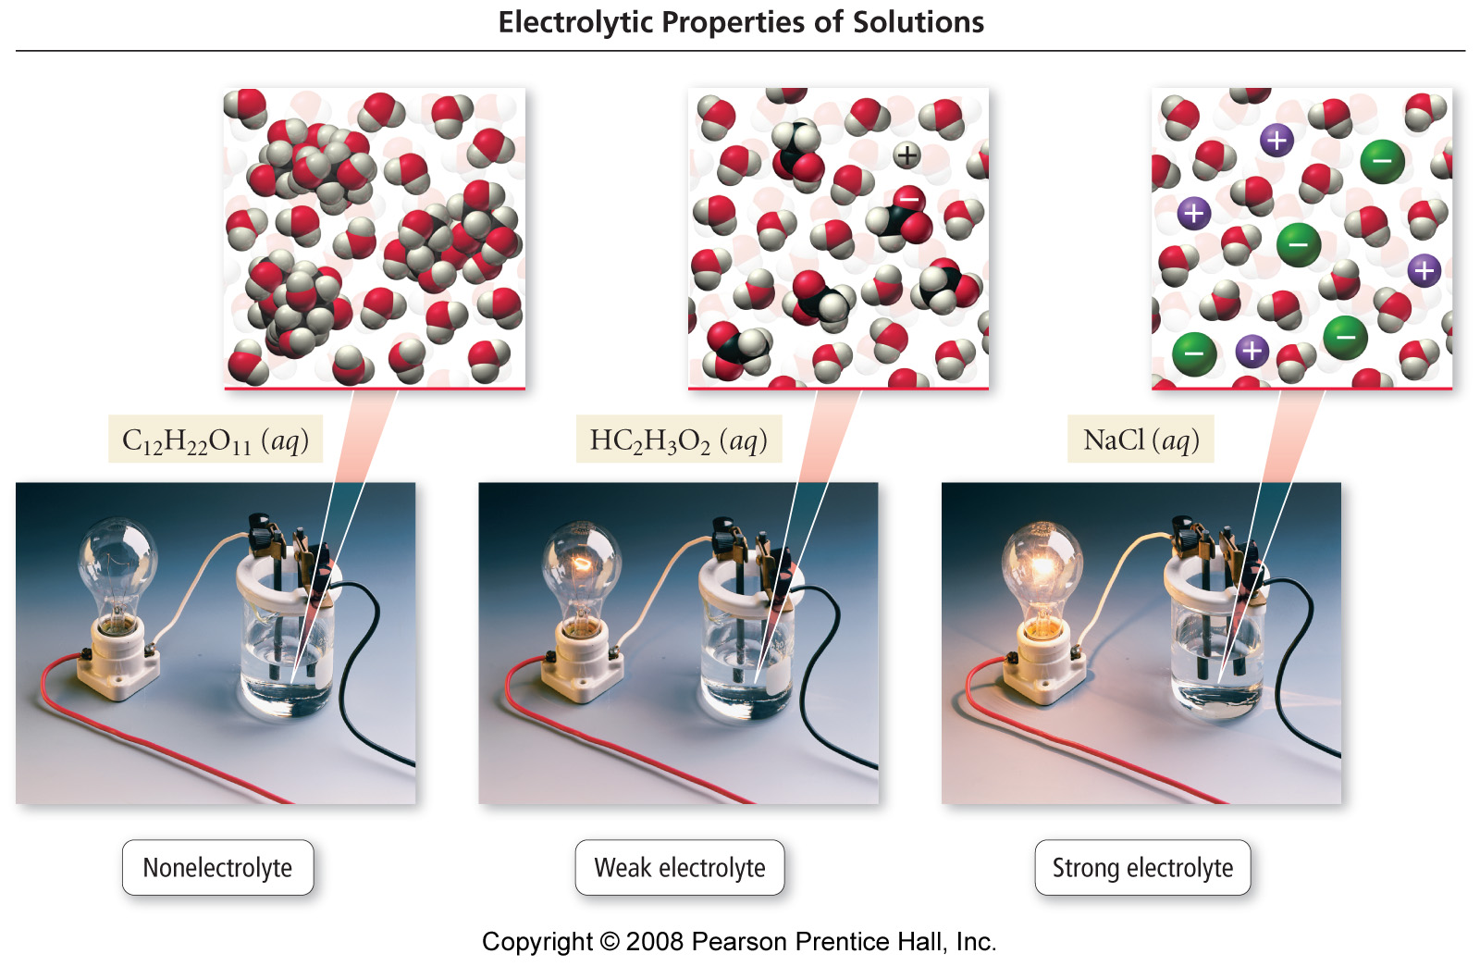
Classes of Dissolved Materials

Slide 16
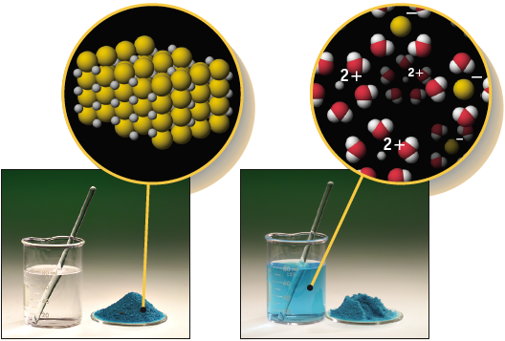
The Nature of a CuCl₂ Solution:
Ion Concentrations
CuCl₂(aq) -->
Cu²⁺(aq) + 2 Cl⁻ (aq)
If [CuCl₂] = 0.30 M, then
[Cu²⁺] = 0.30 M
[Cl⁻] = 2 x 0.30 M

Slide 17

pH, a Concentration Scale
pH: a way to express acidity -- the concentration of H⁺ in solution.
pH = - log [H⁺]
In a neutral solution,
[H⁺] = [OH⁻] = 1.00 x 10⁻⁷ M at 25 ºC
pH = - log [H⁺] = -log (1.00 x 10⁻⁷) = - [0 + (-7)] = 7
Acidic solution pH < 7
Neutral pH = 7
Basic solution pH > 7

Slide 18
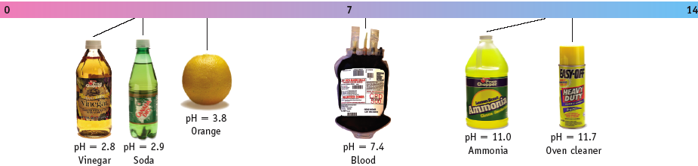
pH, a Concentration Scale
pH = - log [H⁺]
Low pH: high [H⁺]
High pH: low [H⁺]
Acidic solution pH < 7
Neutral pH = 7
Basic solution pH > 7

Slide 19
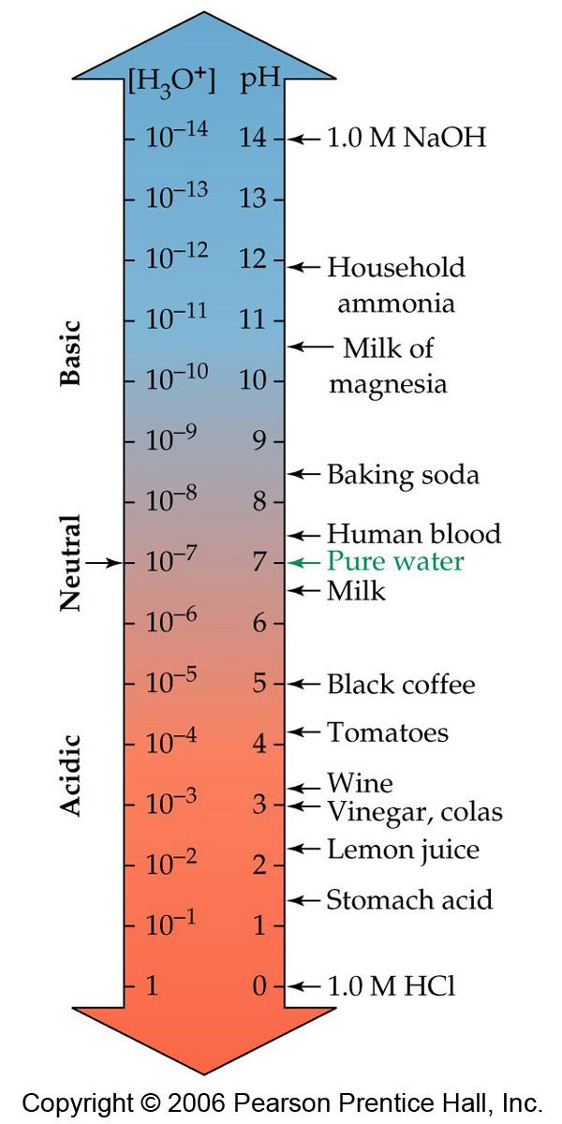

Slide 20
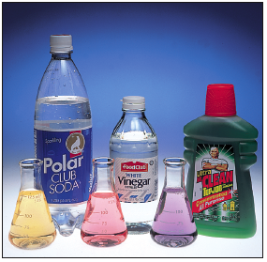
[H⁺] and pH
If the [H⁺] of soda is 1.6 x 10⁻³ M,
the pH is ____?
Because pH = - log [H⁺]
then
pH= - log (1.6 x 10⁻³)
pH = -{log (1.6) + log (10⁻³)}
pH = -{0.20 - 3.00)
pH = 2.80

Slide 21
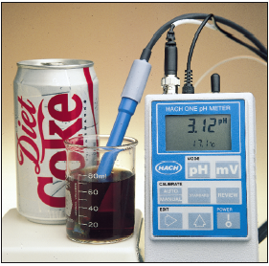
pH and [H⁺]
If the pH of Coke is 3.12, the__ [H⁺] is _ ?__________.
Because pH = - log [H⁺] then
log [H⁺] = - pH
Take antilog and get
[H⁺] = 10^{-pH}
[H⁺] = 10^{-3.12} = 7.6 x 10⁻⁴ M

Slide 22
Solubility of Ionic Compounds
some ionic compounds, like NaCl, dissolve very well in water at room temperature
other ionic compounds, like AgCl, dissolve hardly at all in water at room temperature
compounds that dissolve in a solvent are said to be soluble, while those that do not are said to be insoluble
  NaCl is soluble in water, AgCl is insoluble in water
  the degree of solubility depends on the temperature
  even insoluble compounds dissolve, just not enough to be meaningful

Slide 23
When Will a Salt Dissolve?
Predicting whether a compound will dissolve in water is not easy
The best way to do it is to do some experiments to test whether a compound will dissolve in water, then develop some rules based on those experimental results
  we call this method the empirical method

Slide 24
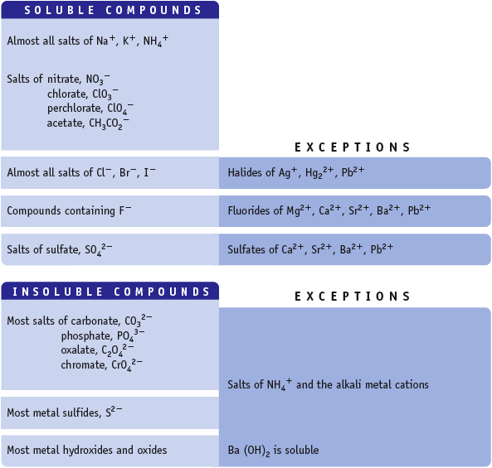
Make some mental notes on this before we tackle a question!
If one ion from the “Soluble Compd.” list is present in a compound, the compound is water soluble.

Slide 25
Solubility Rules
Compounds that Are Generally Soluble in Water
Compounds Containing the Following Ions are Generally Soluble | Exceptions (when combined with ions on the left the compound is insoluble)
Li⁺, Na⁺, K⁺, NH₄⁺ | none
NO₃–, C₂H₃O₂– | none
Cl–, Br–, I– | Ag⁺, Hg₂²⁺, Pb²⁺
SO₄^{2–} | Ag⁺, Ca²⁺, Sr²⁺, Ba²⁺, Pb²⁺

Slide 26
Solubility Rules
Compounds that Are Generally Insoluble
Compounds Containing the Following Ions are Generally Insoluble | Exceptions (when combined with ions on the left the compound is soluble or slightly soluble)
OH– | Li⁺, Na⁺, K⁺, NH₄⁺, Ca²⁺, Sr²⁺, Ba²⁺
S^{2–} | Li⁺, Na⁺, K⁺, NH₄⁺, Ca²⁺, Sr²⁺, Ba²⁺
CO₃^{2–}, PO₄^{3–} | Li⁺, Na⁺, K⁺, NH₄⁺

